Slide 1

Spring of Code
Artificial Intelligence
(Machine Learning & Deep Learning)
Instructor
Asad Ullah
- Research Assistant (DIP Lab)
Duration
03 Months
(February – April)

Slide 2

Day 02 – Linux Shell Scripting Fundamentals
Objectives:
Introduction to Computer?
Introduction to Programming
Introduction to OS
What is an Interface?
Core Commands
Setting Up Python and VS Code

Slide 3
What is a Computer?
What is a computer?
A computer is an electronic device that processes data according to a set of instructions to perform tasks automatically and efficiently.
What is programming or coding?
The process of writing instructions that a computer can understand and execute.
Why do we need programming?
To solve problems efficiently, to create software, websites, apps,
and intelligent systems.
How do we program?
We use programming languages to write instructions that computers can follow. (Python, Java, C++, JavaScript, C#)

Slide 4
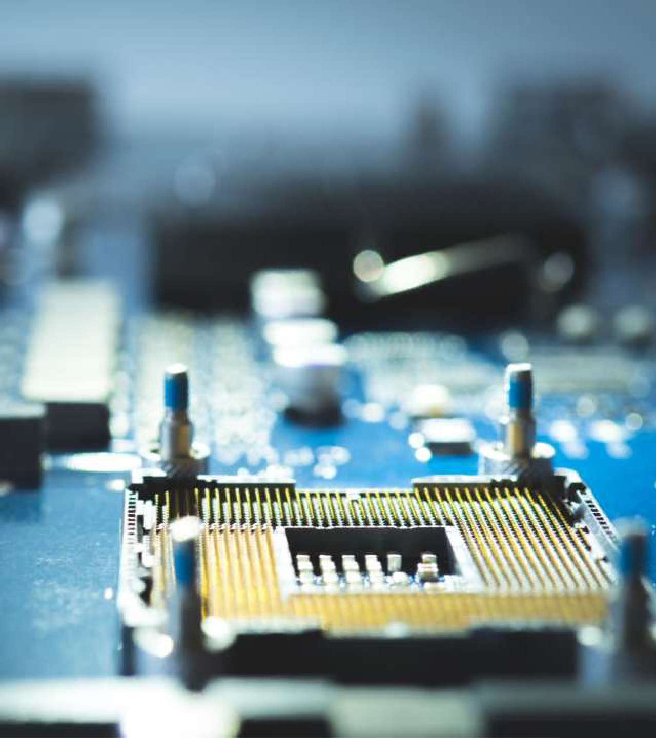
How does a Computer understand the instructions?
The Central Processing Unit
It’s the brain of the computer, made up of
millions (or even billions) of tiny components called transistors.
What is a transistor?
Transistors act like tiny electronic switches or
logic gates. Each gate can be ON or OFF,
which is represented as 1 or 0, forming the
binary language, also called machine language.
Machine language and low-level
languages
Writing code directly in binary (0s and 1s) is
extremely difficult. This kind of programming
is called low-level programming. Other
examples of low-level languages include:
Assembly language (uses mnemonics like MOV, ADD, JMP)

Slide 5
How does a Computer understand the instructions?
High-Level Languages
Programming languages which are easier and more human-readable (e.g. Python)
How Does the Computer Understand High-Level Code?
High-level code must be translated into machine code so the processor can execute it.
Translators
A Compiler translates the entire code at once into machine language (e.g., C, C++). An Interpreter translates and executes code line-by-line (e.g., Python, JavaScript).

Slide 6
How does a Computer understand the instructions?
Aspect | Compiled Language | Interpreted Language
Execution | Entire program is translated into machine code before execution | Code is translated line-by-line during execution
Speed | Generally faster, as it runs machine code directly | Slower, due to line-by-line interpretation
Error Handling | Errors are shown after full compilation | Errors are shown during execution
Output | Produces a separate executable file (e.g., .exe) | No separate executable: runs via interpreter
Examples | C, C++ | Python, JavaScript

Slide 7
Introduction to Operating Systems?
01
What is an OS?
The software that manages hardware and runs your apps.
02
Linux vs Windows in AI Linux is open-source and free. Powers most cloud servers (AWS, Google Colab). Windows is user-friendly, great for local dev with WSL (Windows Subsystem for Linux) for Linux-like experience.
03
You can learn both! Code locally on Windows, deploy on Linux servers

Slide 8
OS Comparisons for AI Work
Aspect | Linux (Ubuntu/Debian) | Windows
Package Management | apt/dpkg – e.g., apt install torch | Chocolatey or winget – e.g., winget install python
Stability | High for servers; fewer crashes in long ML trains | Good for desktops; WSL bridges gap
Cost | Free | Licensed (but free for personal)
AI Tools | Native CUDA support | Requires extra setup for GPUs
Learning Curve | Steeper CLI focus | Gentler with GUIs

Slide 9
Interface
What is an interface?
An interface in OS is the point of interaction between the
user and the system, allowing commands and feedback
GUI (Graphical User Interface)
Visual, mouse-driven comprising Icons, windows, menus for ease
Text-Based (CLI - Command Line Interface) Type commands for precise control e.g., in Terminal/CMD.

Slide 10

Terminal/CMD and Shell
What is Terminal/CMD?
A text-based interface to interact with your OS –
like a command center for your computer.
What is a Shell?
A program that provides direct access to the system on which it runs.
Prompt and Input
Prompt shows the current directory and user

Slide 11
pwd (Print Working Directory) Shows current path. Linux/Windows same.
cd (Change Directory)
cd /path/to/dir or cd .. (up). Windows uses \ for paths.
ls (List)
Lists files/dirs. ls -l for details. Windows: dir.Example: cd
~/ml_project; ls – Navigate to your
AI repo
Navigation Commands

Slide 12
touch
Create empty file: touch data.csv
mkdir
Make Directory: mkdir models
rm
Delete a file or directory: rm file.txt or rm -r dir (recursive). Caution: No recycle bin
rmdir
Remove empty dir: rmdir old_dir.
File Creation and Management

Slide 13
cp
(Copy): cp source dest or cp -r
dir dest.
mv
(Move/Rename): mv source dest mv old new.
Copy & Move

Slide 14
cat
Concatenate: cat file.txt – Dumps
content.
more/less
Paginated view: less huge_log.txt
(q to quit)
head
head -n 10 data.csv – First lines
Viewing Files

Slide 15
command > file (output to file) or >> (append). AI: python train.py > log.txt
Redirection
Redirection
Piping (|)
Chain commands: ls | grep .py –
Find Python files.

Slide 16
sudo
Superuser Do: sudo apt install package – Run as admin
chmod
Change Mode: Linux/Unix command used to modify file or directory permissions, controlling who can read, write, or execute them
chmod [options] mode file
Permission Basics
Permissions apply to three groups: Owner (u): File creator. Group (g): Users in the same group. Others (o): Everyone else. Each group can have:
🞄 r (read, 4): View file contents.
🞄 w (write, 2): Edit file.
🞄 x (execute, 1): Run file (e.g., scripts) or enter directory.
Superuser & Permissions

Slide 17
dpkg
Low-level: dpkg -i package.deb –
Install .deb files
apt (Ubuntu/Debian)
sudo apt update (refresh list), sudo apt upgrade (update packages)
winget (Windows)
winget install Anaconda3
Package Management

Slide 18



Setting Up the Python Environment
Install Python
You can install Python by downloading it from python.org.
Install Visual Studio Code (VS Code)
Download and install VS Code from the official website.
Install some extensions
Python
Code Runner Jupyter

Slide 19
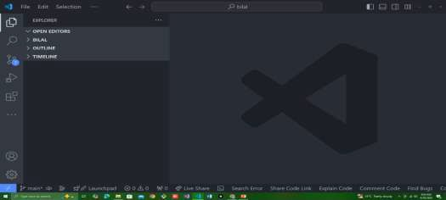


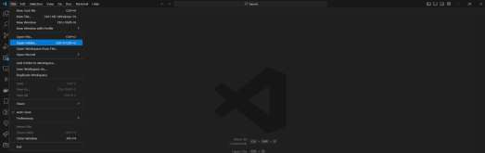


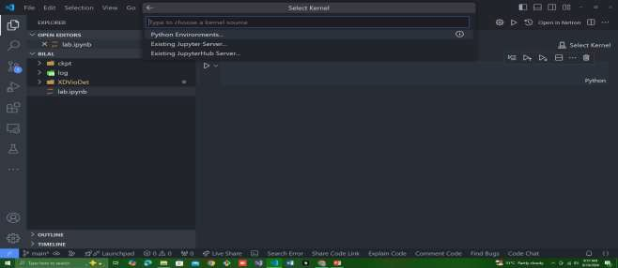




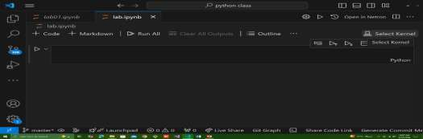

Terminal in VS Code
Working with Files, Folders, Kernel, and
Select a File or Folder in VS Code
🞄 Open VS Code.
🞄 Click on File in the top menu.
🞄 Select Open Folder to choose your project directory.
🞄 Alternatively, click the Explorer icon on the left sidebar and select a file.
Select Jupyter Kernel
🞄 After opening a Jupyter Notebook file (.ipynb):
🞄 Click on the kernel name (top-right of the notebook editor).
🞄 Choose the Python environment or kernel you want to
use for running the notebook.
Open folder
Select your folder and open in visual studio code
Select kernel
19

Slide 20

Happy Coding

